Slide 1
The Top 10 Worst PowerShell Script Mistakes
Adam Bertram

Slide 2

PS> Whoami
PowerShell MVP
Consultant (Automation Engineer)
Pluralsight Author (http://bit.ly/adambpluralsight)
Freelance Writer
Blogger: adamtheautomator.com
Twitter: @adbertram

Slide 3
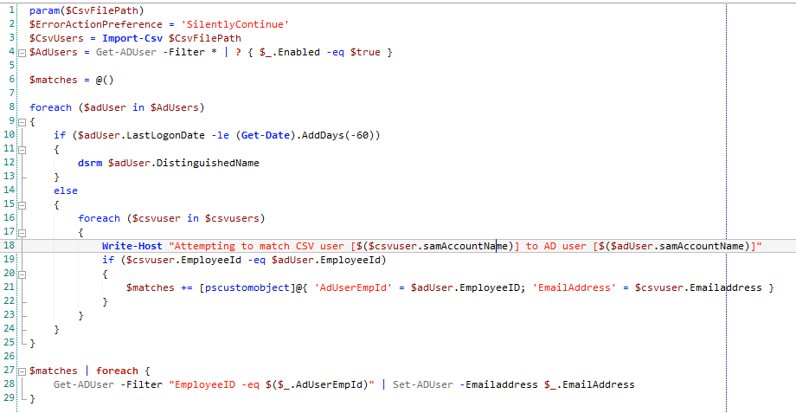
Let’s Play Spot the Mistake
What if $CsvFilePath –eq CLJDF:\dlj%%@@?
Soooo.. you don’t care if errors occur?
Always remember..filter LEFT
Aliases are the devil
Did we lose Remove-AdUser somewhere? I must be pretty confident to auto-remove users.
Write-Host kills puppies
Are you trying to make your script slower?
…but I have EmployeeNumber!
foreach –ne foreach

Slide 4
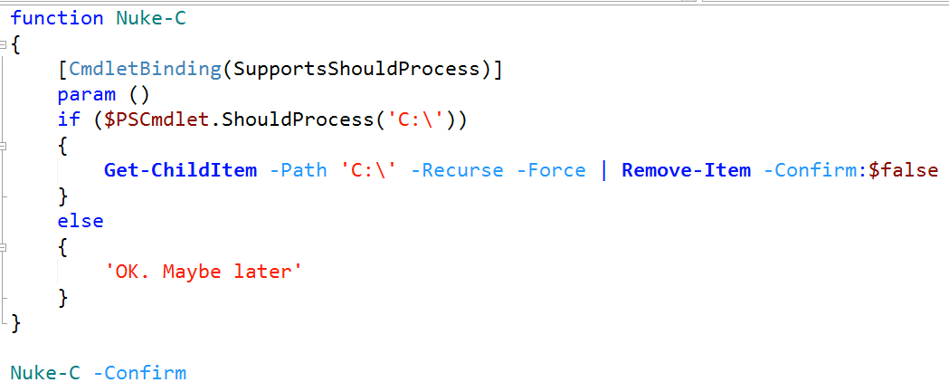

#10 – Not Using -Whatif
BAD
GOOD
Dead Puppy Scale:

Slide 5
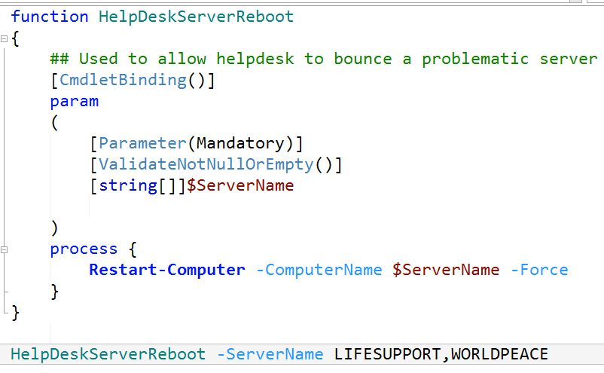
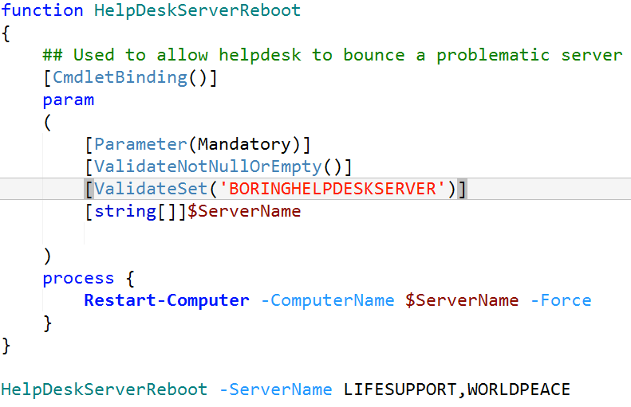
#9 – Not Limiting Input
BAD
GOOD
Dead Puppy Scale:

Slide 6
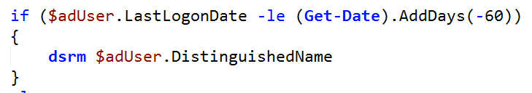
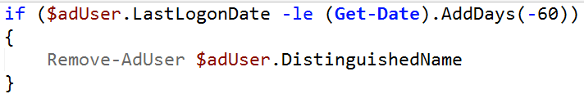
#8 – Using External Utilities
BAD
GOOD
Dead Puppy Scale:

Slide 7
#7 – Not Enough Parameters
BAD
GOOD
Dead Puppy Scale:

Slide 8
#6 – Silencing Errors
BAD
GOOD
Dead Puppy Scale:

Slide 9
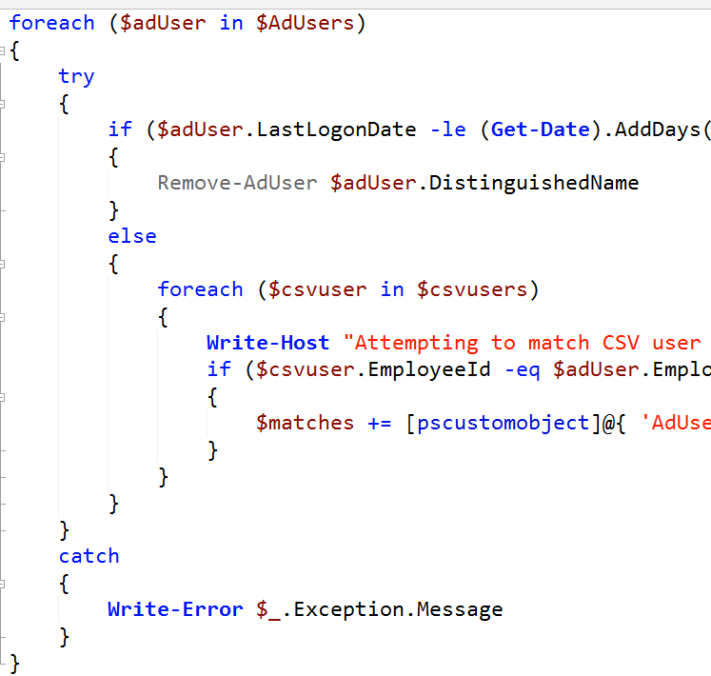
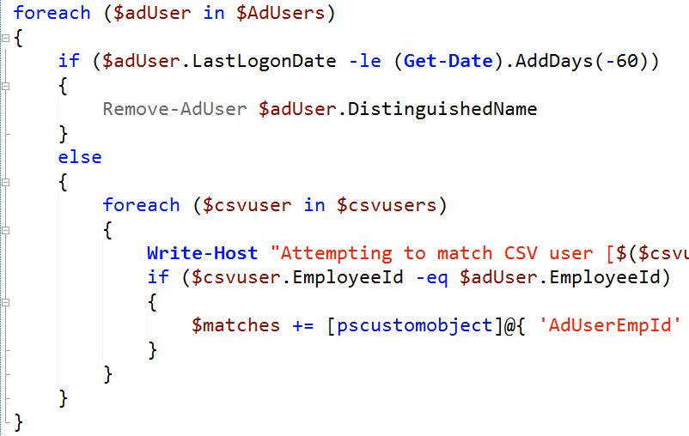
#5 – No Error Handling
BAD
GOOD
Dead Puppy Scale:

Slide 10
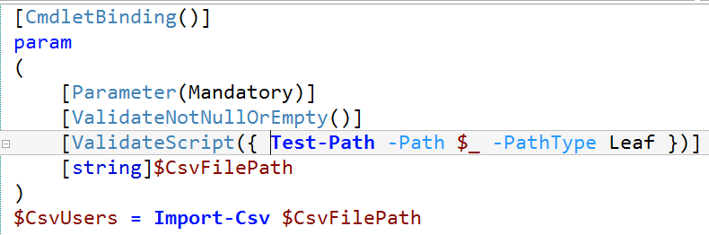

#4 – No Validation
BAD
GOOD
Dead Puppy Scale:

Slide 11
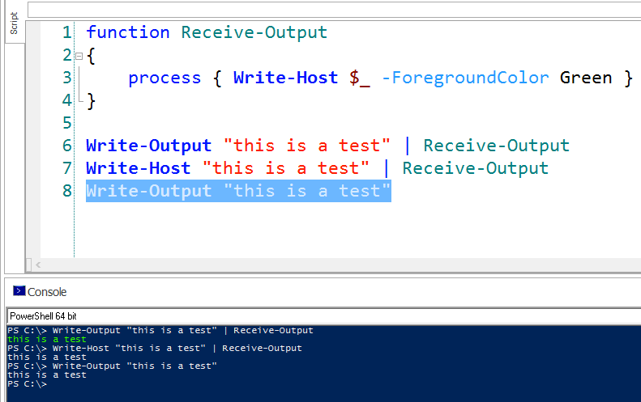
#3 – Write-Host –ne Write-Output
Dead Puppy Scale:

Slide 12
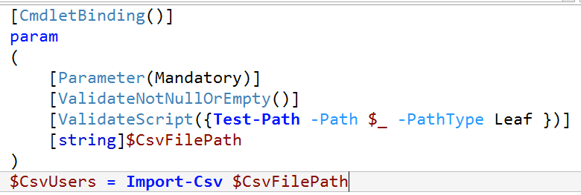
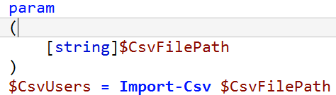
#2 – No Advanced Functions
BAD
GOOD
Dead Puppy Scale:

Slide 13
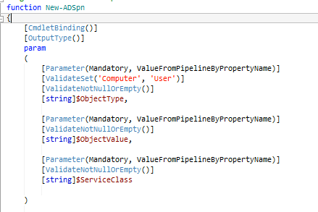
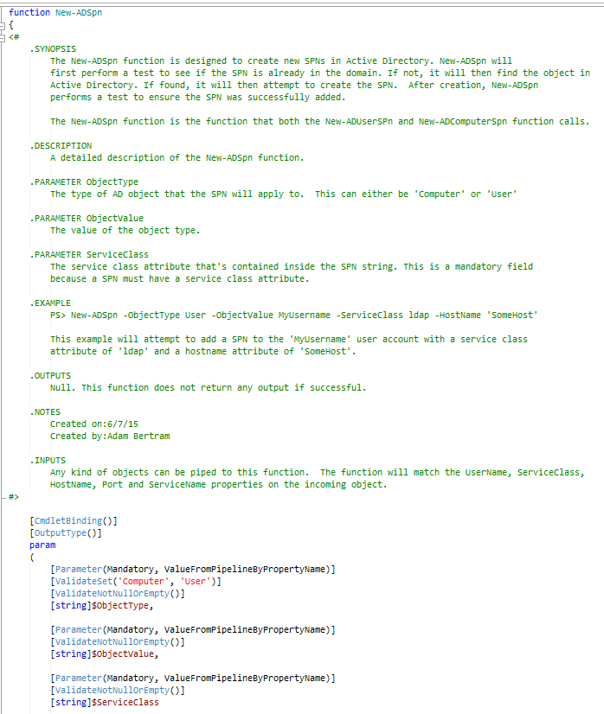
#1 – No Comment-Based Help
BAD
GOOD
Dead Puppy Scale:

Slide 14

Save the Puppies!

